Slide 1
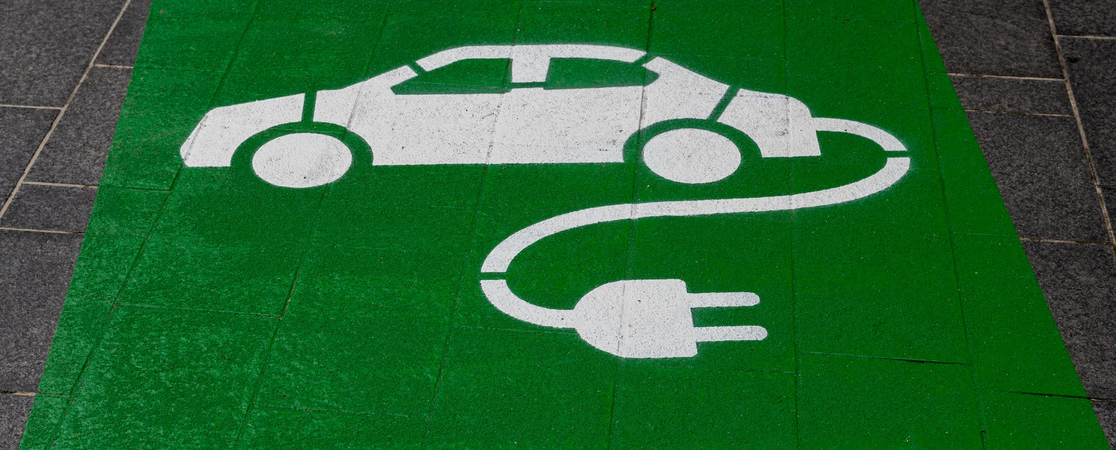
Electric Vehicle Charging
Proposal for our Building
[Fill in information where highlighted in blue]
Notes:
This is complementary to the Charging Empowerment Toolkit. Please check this document out for background and details prior to presenting.
This is a slideshow template, so please customize for your building and situation for best effect.
Highlighted areas (light blue color) are areas you should edit for your specific situation

Slide 2
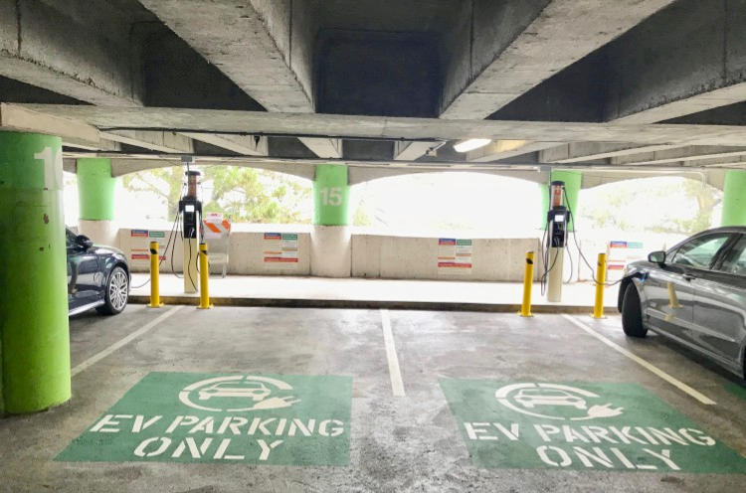
Contents
Trends
Benefits
Survey results
Incentives
Proposal

Slide 3
Source: “The Ultimate Guide to EV Charging.” Slide 6. 2 Aug 2022. SemaConnect Webinar https://bit.ly/3w6PIUI.
Notes:
GM and Volkswagen are going all electric for their cars by 2035
Electric vehicles have 16.3% market share of light duty vehicles sold in California in Q2 2022.
Source: “The Ultimate Guide to EV Charging.” Slide 7. 2 Aug 2022. SemaConnect Webinar https://bit.ly/3w6PIUI.

Slide 4
Benefits
Attract new residents
Provides a desirable amenity
Increase resident retention rate
Future-proofing your building as the auto industry moves to electric
Revenue stream
Recover installation/ongoing costs
Notes:
Think about what the property manager wants and tailor all slides to those needs.

Slide 5
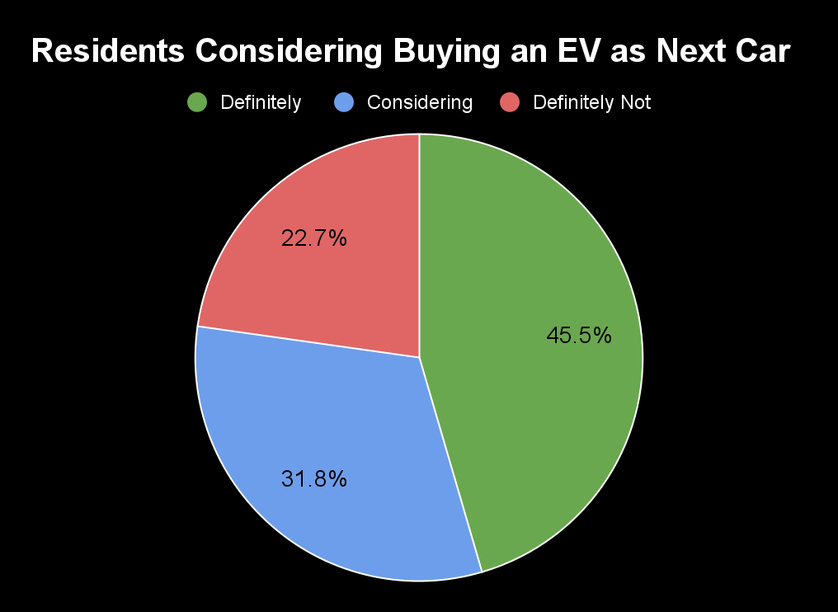
Survey Results
[Formal or informal survey results
How many EVs are in the building?
How many are looking for EV charging capability, now or in the near future?
If you build it, they will come…
Update chart to right with own your own survey data by selecting the top right corner or create new one, whatever displays the results most favorably ]
Notes:
It is very important to the property management/HOA that if they are spending money, it will be something useful to the residents
You need to understand the community need for charging before talking to the Prop Manager/HOA

Slide 6
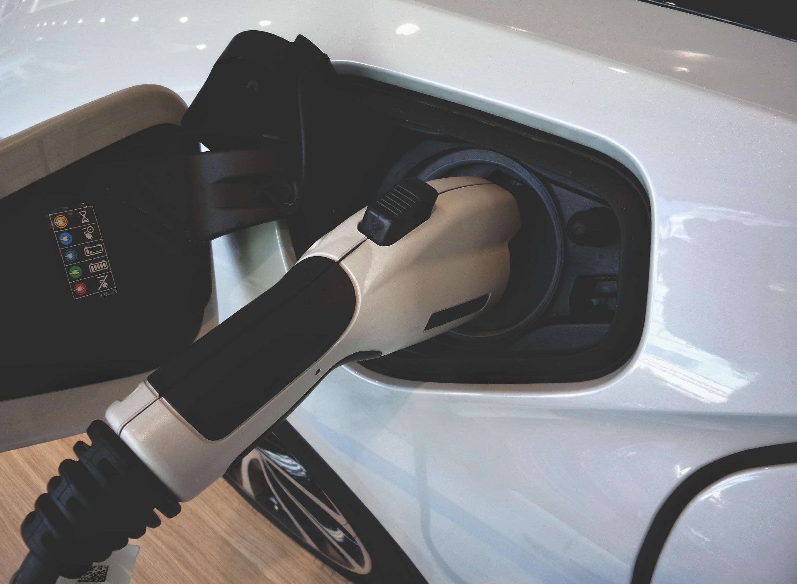
Incentives
Federal Infrastructure Tax Credit
Check with your Tax Advisors for more information
State Incentives
https://afdc.energy.gov/laws/state
https://plugstar.zappyride.com/tools/incentives
[Review resources above and add state incentives]
Utility incentives
Contact [insert utility here]
Ask a Charging company representative for more details on the incentives in your area
Notes:
Go to your utility’s website and identify incentives/ technical assistance/programs regarding EV charging

Slide 7
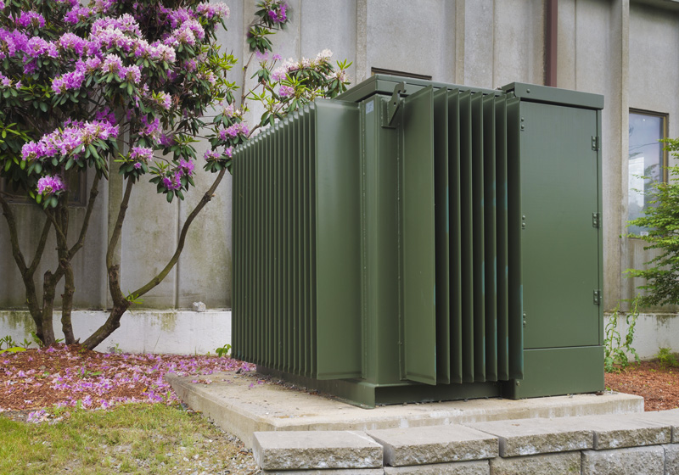
Reasons to contact your Utility
Rebates
Grants
EV Charging rates
Technical assistance
Programs coming soon
Notes:
Moving to Incentives
Utilities want to know what electricity demand in their territory will be in the future, EVs are a major source of load growth. They want to know and many have programs to install EV charger installation. Additionally, they may be able to contribute to upgrading service equipment or helping you with EV charger selection, siting, and more. First things first, check their website, and when you are ready to consider installing EV chargers, reach out to them.

Slide 8
Next Steps
Approval to Develop a Plan
Allocate funds for plan development
Create the Plan
Perform Site Assessment with Electrician
Create site plan (Consultant or Vendor)
Project Approval
Review plan detail and cost with [HOA/PM]
Leverage incentives, rebates
Installation Decision: Go/No Go
Installation
Community Communication
[State here how you can support the effort]

